Slide 1
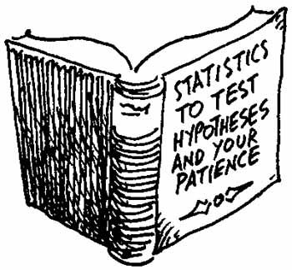
Hypotheses testing about a population mean
Classical approach

Slide 2
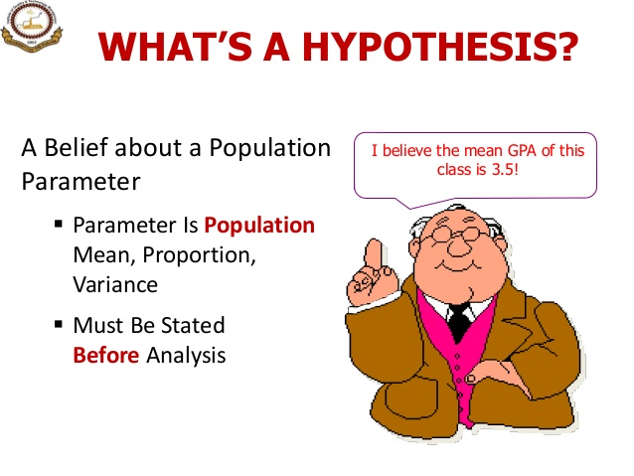

Slide 3
Hypothesis in Statistics…
E
In statistics, a hypothesis is a claim or statement about a property of a population.
The mean salary of new college graduates is $45,000 per year. This is a hypothesis about a population mean. In many situations we need to test this claim or hypothesis to see if it is true or not.

Slide 4

A parallel between hypothesis testing and a trial in a court of law
Hypothesis testing is similar to a trial in a court of law.
The defendant is considered to be innocent until it is proven otherwise. The prosecutor has to find enough evidence to prove that the defendant is guilty. If the evidence is not enough, the defendant will be considered innocent.
The innocence is defined, in statistics, by the null hypothesis. The guiltiness, on the other hand, is defined by the alternate (or alternative) hypothesis.

Slide 5

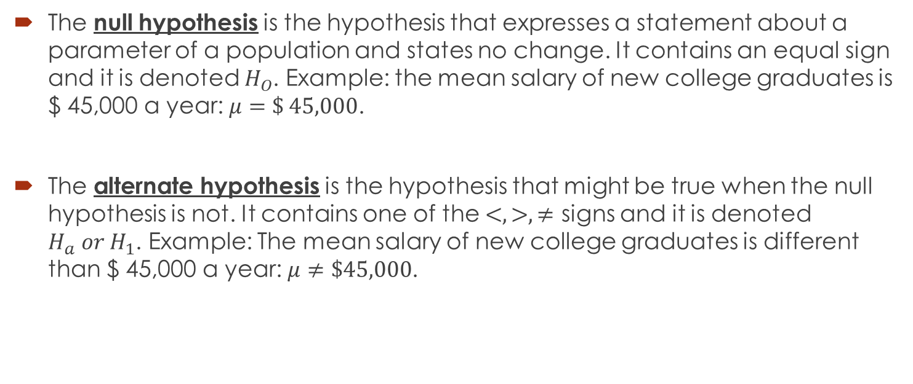

$H_{O}$versus $H_{a}$
The null hypothesis is the hypothesis that expresses a statement about a parameter of a population and states no change. It contains an equal sign and it is denoted $H_{O}$. Example: the mean salary of new college graduates is $ 45,000 a year: $μ=\$ 45,000$.
The alternate hypothesis is the hypothesis that might be true when the null hypothesis is not. It contains one of the $<, >, ≠$ signs and it is denoted $H_{a} or H_{1}$. Example: The mean salary of new college graduates is different than $ 45,000 a year: $μ≠\$45,000$.

Slide 6
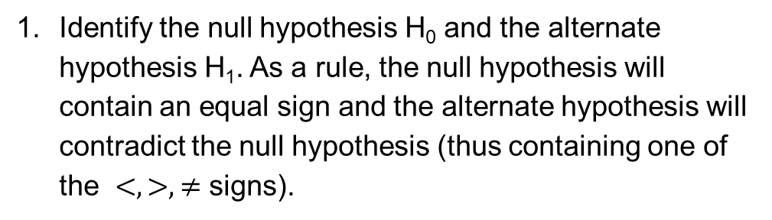
Steps for hypotheses testing
1 Identify the null hypothesis H₀ and the alternate hypothesis H1.
Identify the null hypothesis H₀ and the alternate hypothesis H₁. As a rule, the null hypothesis will contain an equal sign and the alternate hypothesis will contradict the null hypothesis (thus containing one of the $<, >, ≠$ signs).

Slide 7
In a court of law, there are 2 possible errors: a) Finding the defendant guilty when he is innocent; b) Finding the defendant innocent when he is guilty.
In hypothesis testing, these 2 types of errors translate as follows:
a) Type I error: The mistake of rejecting the null hypothesis when it is true. For instance, in the above example, rejecting the hypothesis of mean salary being $45,000 when, in fact, it is true.
b) Type II error: The mistake of failing to reject the null hypothesis when it is false. For instance, in the above example, failing to reject the hypothesis of mean salary being $45,000 when, in reality, it is not true.

Slide 8
In conclusion Type I and II Errors:
The size of α , the rejection region, affects the risk of making different types of incorrect decisions.
Type I Error
Rejecting a true null hypothesis when it should NOT be rejected
Considered a serious type of error
The probability of Type I Error is α
It is also called level of significance of the test
Type II Error
Fail to reject a false null hypothesis that should have been rejected
The probability of Type II Error is β

Slide 9
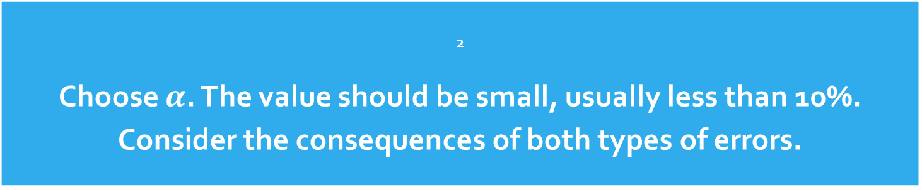
Steps - continued
2 Choose $α$. The value should be small, usually less than 10%. Consider the consequences of both types of errors.
2. Choose the level of significance and determine the critical region by calculating the critical value(s).
There are 3 possibilities for the acceptance region:

Slide 10
Acceptance region
Represents
critical value
a
H₀: μ = 12 H₁: μ ≠ 12
a
/2
/2
Two-tail test
0
H₀: μ = 12 H₁: μ > 12
a
Rejection region is shaded
Upper-tail test
0
H₀: μ = 12 H₁: μ < 12
a
Lower-tail test
0

Slide 11
2 possibilities:
If the test statistic is situated inside the acceptance region, we fail to reject the null hypothesis.
If the test statistics is situated in the critical region, we reject the null hypothesis.

Slide 12
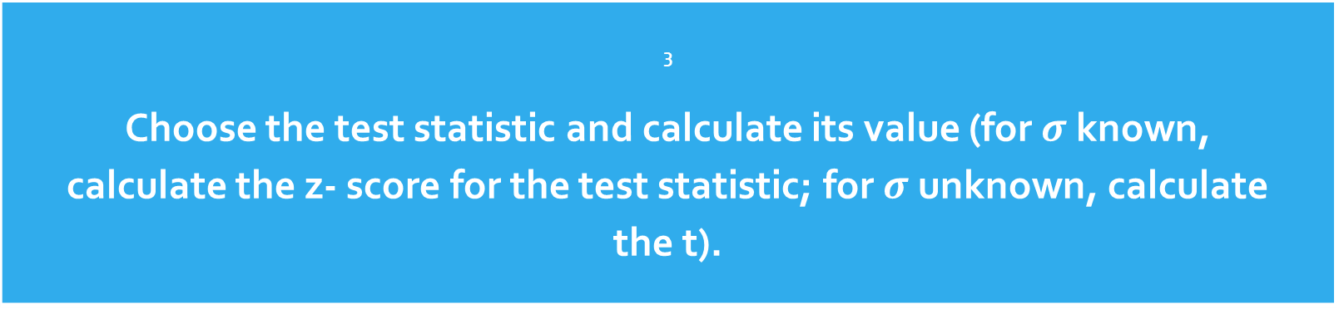
Steps - continued
3 Choose the test statistic and calculate its value (for $σ$ known, calculate the z- score for the test statistic; for $σ$ unknown, calculate the t).

Slide 13


Test of Hypothesis for the Mean
σ known
σ Unknown
The test statistic is:
$$z= \frac{\overline{x} − μ}{\frac{σ}{\sqrt{n}}}$$
The test statistic is:
$$t= \frac{\overline{x} − μ}{\frac{s}{\sqrt{n}}}$$

Slide 14
Steps continued
4 Compare the observed value of the statistic to the critical value obtained for the chosen level of significance and make a decision. Make a decision to reject/fail to reject the null hypothesis. Compare the z - score of the test statistic to the values of z that constructed the critical region. If the z - score of the test statistics falls in the critical region, we reject the null hypothesis. If it falls inside the acceptance zone, we fail to reject the null hypothesis.

Slide 15
Steps continued
5) State a conclusion

Slide 19
Steps to Hypothesis testing, continued
Make statistical decision
Fail to Reject H₀
Reject H₀
Conclude H₀ may be true
Conclude H₁ is “true”
(There is sufficient evidence of H1)
Make management/business/administrative decision

Slide 20
Note
We are rejecting the null hypothesis or failing to reject the null hypothesis. That does not mean that we are proving the null hypothesis. We simply state that the evidence is enough to reject or to fail to reject the null hypothesis.

Slide 21

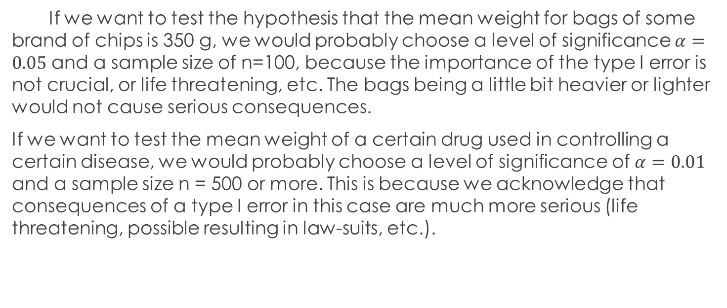
The values of $α, β, and n are related$. If type I error has serious consequences, we should choose a smaller value for $α.$
E
If we want to test the hypothesis that the mean weight for bags of some brand of chips is 350 g, we would probably choose a level of significance $α=0.05$ and a sample size of n=100, because the importance of the type I error is not crucial, or life threatening, etc. The bags being a little bit heavier or lighter would not cause serious consequences.
If we want to test the mean weight of a certain drug used in controlling a certain disease, we would probably choose a level of significance of $α=0.01$ and a sample size n = 500 or more. This is because we acknowledge that consequences of a type I error in this case are much more serious (life threatening, possible resulting in law-suits, etc.).

Slide 22
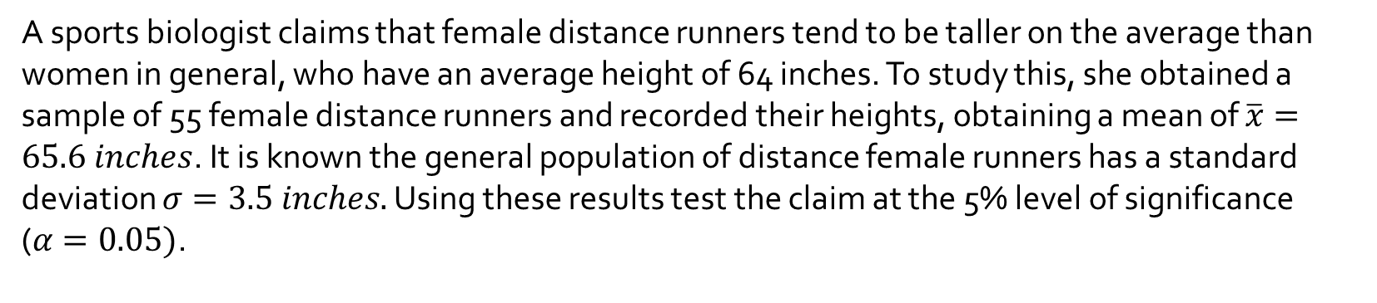
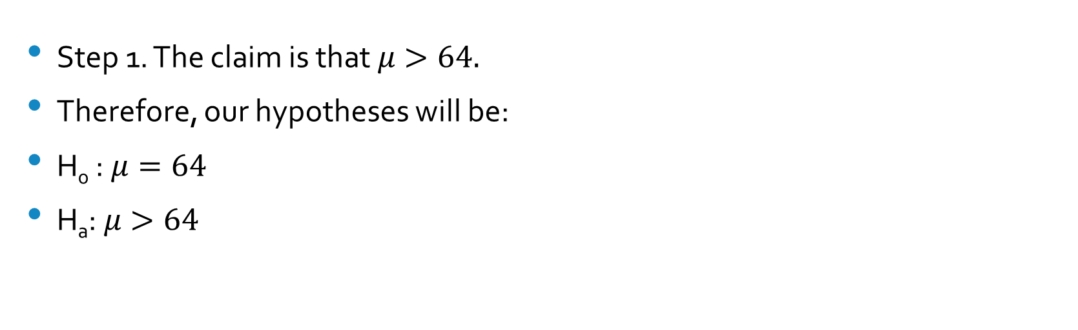
A sports biologist claims that female distance runners tend to be taller on the average than women in general, who have an average height of 64 inches. To study this, she obtained a sample of 55 female distance runners and recorded their heights, obtaining a mean of $\overline{x}=65.6 inches$. It is known the general population of distance female runners has a standard deviation $σ=3.5 inches.$ Using these results test the claim at the 5% level of significance ($α=0.05)$.
Q
Step 1. The claim is that $μ>64.$
Therefore, our hypotheses will be:
H₀ : $μ=64$
H_{a}: $μ>64$

Slide 23
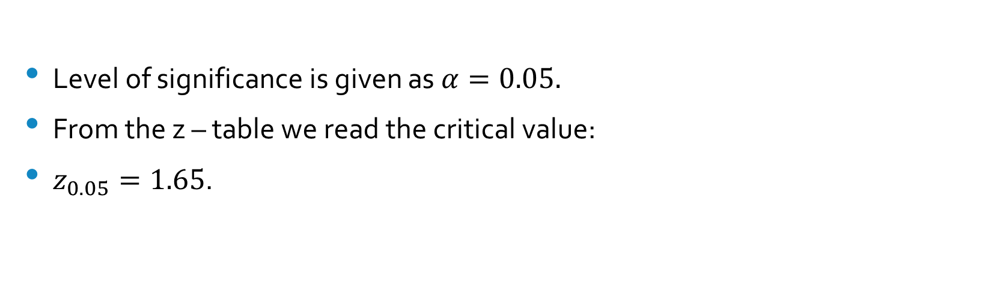
Step 2
Level of significance is given as $α=0.05.$
$\text{From} \text{the} \text{z}\text{ – }\text{table} \text{we} \text{read} \text{the} \text{critical} \text{value}\text{:}$
$z_{0.05}=1.65$.

Slide 24
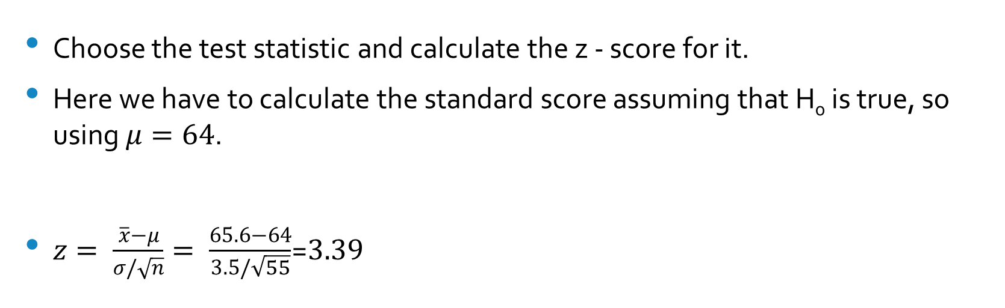
Step 3
Choose the test statistic and calculate the z - score for it.
Here we have to calculate the standard score assuming that H₀ is true, so using $μ=64$.
$z= \frac{\overline{x}−μ}{σ/\sqrt{n}}= \frac{65.6−64}{3.5/\sqrt{55}}$=$3.39$

Slide 25
Step 4. Make a decision.
Since the z- score for the observed value is inside the critical region, we reject the null hypothesis.

Slide 26
Step 5. Draw a conclusion
At the 5% level of significance, we found enough evidence to support the claim that that female distance runners tend to be taller on the average than women in general.

Slide 27
When do we use a two-tail test? When do we use a one-tail test?
The answer depends on the question you are trying to answer.
A two-tail is used when the researchers have no idea which direction the study will go, so they are interested in both directions.
(Example: testing a new technique, a new product, a new theory and we don’t know the direction). A new machine is producing 12 fluid ounce can of soft drink. The quality control manager is concerned with cans containing too much or too little.
12

Slide 28
One-tail test is used when the researcher is interested in one direction.
Example: The soft-drink company puts a label on cans claiming they contain 12 oz. A consumer advocate desires to test this statement. She would assume that each can contains at least 12 ounces and tries to find evidence to the contrary. That is, she examines the evidence for less than 12 0z.
What tail of the distribution is the most logical (higher probability) to find that evidence? The only way to reject the claim is to get evidence of less than 12 ounces, left tail.
11.5
12
14

Slide 29
Practice
Studies suggests that the mean of Siamese cats’ weight is 12.3 pounds. A vet thinks that the mean might be bigger for Siamese cats since the introduction of a new brand of cat food. She chooses a sample of 10 cats and finds the mean weight to be 13.5 pounds with a standard deviation of 3.4 pounds. Assume the population of weights is normally distributed.
Test the claim at a level of significance of 5%.
State the hypotheses
State the level of significance and construct the critical interval
Calculate the test statistics
Make a decision
State a conclusion

Slide 33
2. A cosmetics company fills jars of facial cream by an automatic dispensing machine. The machine is set to dispense a mean of 8.1 ounces per jar. Uncontrollable factors in the process can shift the mean away from 8.1 and cause either under fill or overfill, both of which are undesirable. In such a case the dispensing machine is stopped and recalibrated. Regardless of the mean amount dispensed, the standard deviation of the amount dispensed for the population has the value of 0.22 ounce. A quality control engineer routinely selects 60 jars from the assembly line to check the amounts filled. The sample mean was 8.2 ounces. Determine if there is sufficient evidence in the sample to indicate, at the 1% level of significance, that the machine should be recalibrated.

Slide 34
State the hypotheses
State the level of significance and construct the critical interval
Calculate the test statistics
Make a decision
State a conclusion

Slide 38
3. A magazine publisher tells potential advertisers that the mean household income of its regular reader is $61,500. An advertising agency wishes to test this claim against the alternative that the mean is smaller. A sample of 31 randomly selected regular readers yields mean income $59,800 with standard deviation $5,850. Perform the relevant test at the 1% level of significance.

Slide 39
State the hypotheses
State the level of significance and construct the critical interval
Calculate the test statistics
Make a decision
State a conclusion

Slide 43
4. Authors of a computer algebra system wish to compare the speed of a new computational algorithm to the currently implemented algorithm. They apply the new algorithm to 31 standard problems; it averages 8.16 seconds with standard deviation 0.17 second. The current algorithm averages 8.21 seconds on such problems. Test, at the 1% level of significance, the alternative hypothesis that the new algorithm has a lower average time than the current algorithm.

Slide 44
State the hypotheses
State the level of significance and construct the critical interval
Calculate the test statistics
Make a decision
State a conclusion

Slide 48
5. A professor gives his class a final examination that he knows from years of experience yields a population mean of 84 and a standard deviation of 8. His present class of 24 obtains a mean of 88. Test the claim that the current test results differ from the old ones. Test at a 5% level of significance. Consider the population normally distributed.

Slide 49
State the hypotheses
State the level of significance and construct the critical interval
Calculate the test statistics
Make a decision
State a conclusion

Slide 53
Example
A researcher found that a cigarette smoker smokes on average of 30 cigarettes a day. She feels that this average is too high. She selected a random sample of 9 smokers and found that the mean number of cigarettes they smoked per day was 29. The sample standard deviation was 2.3.
At 0.05 level of significance, is there enough evidence to support her claim? Assume that the population is approximately normally distributed. Use the critical value method and tables.
(a)State the hypotheses and identify the claim.
(b)Find the critical value.
(c)Compute the test value.
(d)Make the decision.
(e)Summarize the results.

Slide 54

Part 1 of 5
H₀ : $μ=$30 (Not claim)
H_{a}: $μ<$30 (Claim)
This hypothesis test is a left tail test.
Part 2 of 5
Critical value(s): -1.860

Slide 55
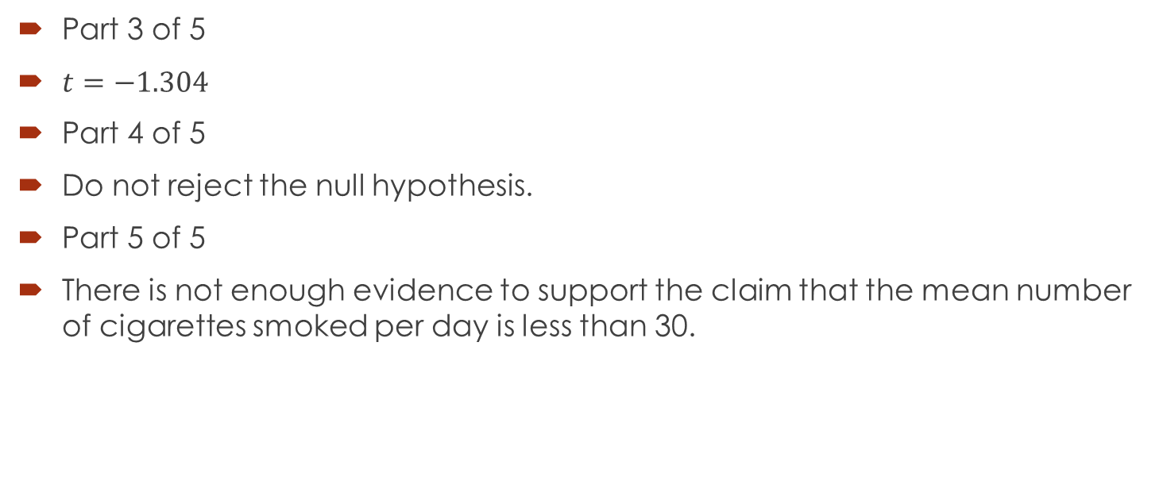
Part 3 of 5
$t=−1.304$
Part 4 of 5
Do not reject the null hypothesis.
Part 5 of 5
There is not enough evidence to support the claim that the mean number of cigarettes smoked per day is less than 30.

